Slide 1
Highlights from the annual report and activities to date
Zoe Robinson, Managing Director, Kaplan Assessments

Slide 2
Candidate feedback
The assessment centres were well organised and invigilators incredibly helpful, which eased the pressure of the exam (to a certain extent!)
Organisation was great, very thorough, people were friendly but disciplined
The invigilators at both the Islington (oral exams) and Oxford (written) centres went above and beyond to ensure that we could be as comfortable and at ease as possible, they were so kind and ran the days so seamlessly
The staff were very professional. Centre was neat and comfortable. They [staff] were attentive throughout the assessment
Venue accessible and very supportive staff
The assessment was well structured and organised, especially my oral exams

Slide 3
Candidate feedback
I appreciated that all relevant information was easily accessible and helped me feel prepared
The process was smooth, and the support provided helped ensure a fair and transparent assessment experience
Very efficient service, everything was explained properly and went smoothly from start to finish. Thank you for your great service
The website provided comprehensive information about what to expect on the day, including guidance on the assessment process and venue details, which were well-organised

Slide 4
SQE1 pass rates
Date | Pass rate overall
January 2024 | 56%
July 2024 | 44%
January 2025 | 56%

Slide 5
2024 SQE1 pass rates
Date | All (FLK1 and FLK2) | First attempt only | Second attempt only | Third attempt only
January | 56% | 59% | 16% | -
July | 44% | 48% | 21% | 17%

Slide 6
2024 SQE2 pass mark and rate
Date | Pass mark | Pass rate (overall/all candidates)
January | 61-62% (both sittings) | 74%
April | 61-62% (all four sittings) | 79%
July | 61-62% (all four sittings) | 74%
October | 61% (all three sittings) | 81%

Slide 7
Setting the pass mark for SQE1
Tim Maddison, Legal Academic Director, Kaplan Assessments

Slide 8
SQE Marking and Standard Setting Policy
Candidate Score
Paragraph 1.2
Each correctly answered question will receive one mark.
The number of marks is added together to provide the candidate score for the relevant assessment.
For example, 114 out of 180

Slide 9
SQE Marking and Standard Setting Policy
Pass Mark
Paragraph 1.8
The pass mark will be the number of correctly answered questions needed to pass the assessment.
For example, 105 out of 180 correctly answered questions required to pass.
Note: the scaled pass mark presented to candidates will always be 300.

Slide 10
SQE Marking and Standard Setting Policy
Pass Mark
Paragraph 1.3
The cut score for an assessment will be determined by the Assessment Board.
When determining the cut score, the Assessment Board will have reference to the standard determined by:
  a Modified Angoff method
  other recognised standard setting methods as appropriate,
  as well as statistical equating

Slide 11
Angoff method
Paragraph 1.4
A panel of qualified solicitors (familiar with day one competence)
Consider, for each question in an assessment, how many out of ten just competent Day One solicitors would answer the question correctly.
Opportunity for discussion and adjustment of scores.
Notes:
Split up your text and use it as an aid, rather than just reeling off more information. Eg, here we are talking about who we are. We can elaborate on other legal regulators, or ask the audience if they’ve ever used a solicitor or heard of us before.

Slide 12
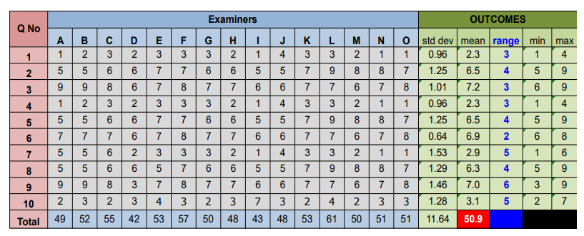
Angoff method
Notes:
Split up your text and use it as an aid, rather than just reeling off more information. Eg, here we are talking about who we are. We can elaborate on other legal regulators, or ask the audience if they’ve ever used a solicitor or heard of us before.

Slide 13
SQE Marking and Standard Setting Policy
Pass Mark
Paragraph 1.3
The Board will have reference to the standard determined by:
  a Modified Angoff method
  other recognised standard setting methods as appropriate
  as well as statistical equating
Paragraph 1.5
The standard setting process (ie Modified Angoff method) is repeated periodically. In between times, the standard of assessments is maintained using statistical equating.

Slide 14
Equating
Test A and Test B have a number of common questions
Test A: candidates score 50% on common questions, and score 55% on the other questions
Test B: candidates score 50% on common questions and score 45% on the other questions
Candidates = similar ability
Test B = more difficult = lower pass mark

Slide 15
Cut score to pass mark
Paragraph 1.7
Pass mark = cut score plus a multiple of the standard error of measurement

