Slide 1
Practical solutions to improve candidate experience
Julie Swan, Director of Education and Training, SRA (Chair)
Tim Allen, Head of Candidate Services, Kaplan SQE
Yiannis Chrysanthou, Head of Stakeholder Engagement, Kaplan SQE
Tim Maddison, Legal Academic Director, Kaplan Assessments
Jackie Panter, Head of Equality and Quality, Kaplan SQE

Slide 2
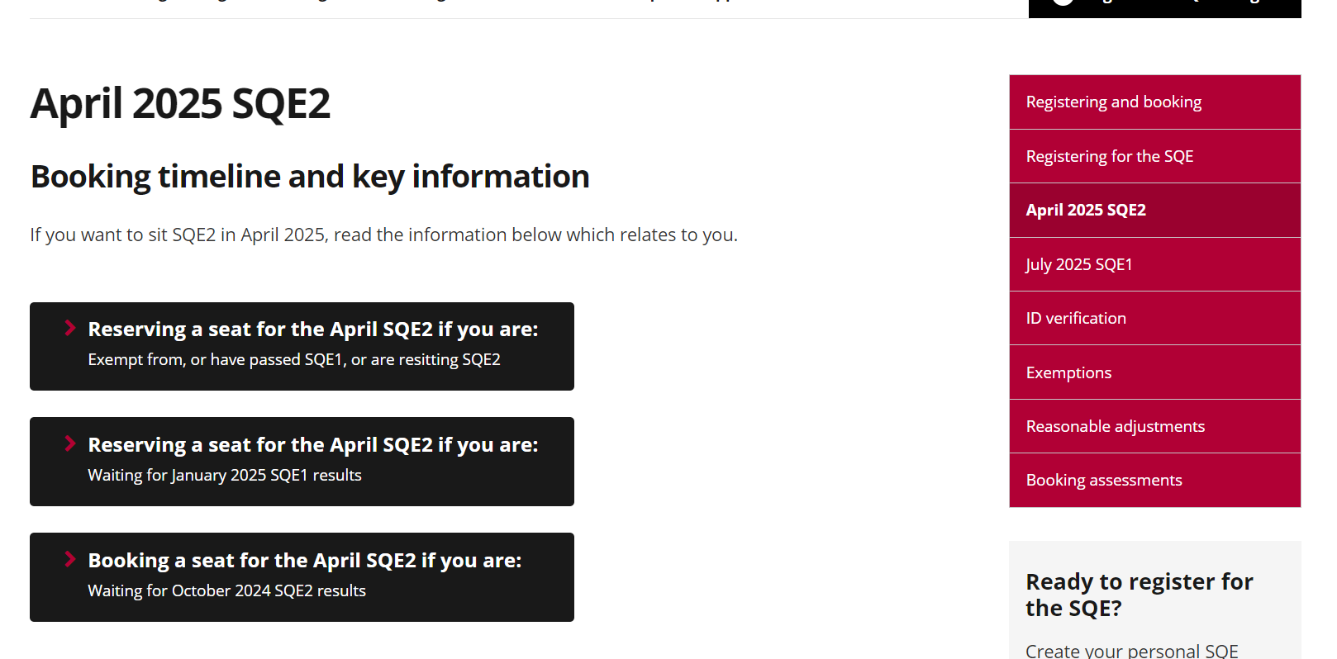
Booking information
Dedicated webpage for each
booking window
Linked from the Timings page
https://sqe.sra.org.uk/timings
Notes:
Tim Allen

Slide 3
Candidate case studies
Written by former SQE candidates
Different candidate perspectives on how to prepare
SQE candidate case studies https://sqe.sra.org.uk/about-sqe/case-studies
Notes:
Yiannis

Slide 4
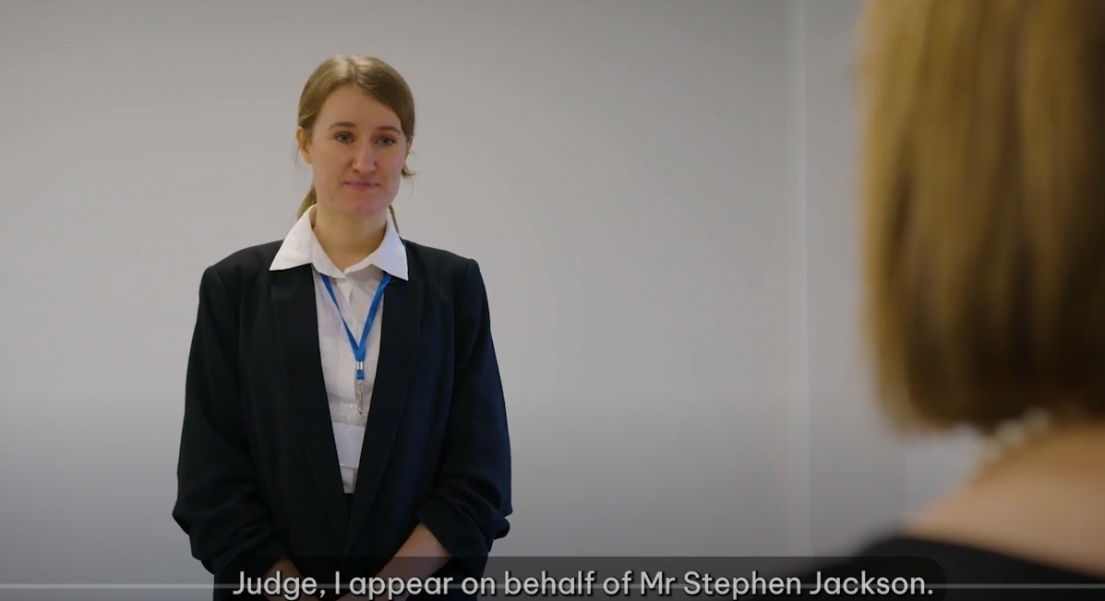
SQE2 sample recordings
Advocacy
Criminal Litigation
Client interviewing
  Wills & Intestacy, Probate Administration
Property Practice
Notes:
Yiannis

Slide 5
SQE news updates
Key news and updates
Email alert when news item is published
SQE News https://sqe.sra.org.uk/sqe-news
Notes:
Yiannis

Slide 6
How to make a claim for mitigating circumstances
Key steps to make a claim:
          submit your mitigating circumstances form via the SQE Portal
          your claim will be acknowledged within 5 working days
          next an investigation and obtaining evidence
          the Mitigating Circumstances Panel will consider your claim
          then the Assessment Board will consider the recommendations from the panel and decide on your claim
          we will send you the outcome via email.
Notes:
Jackie

Slide 7
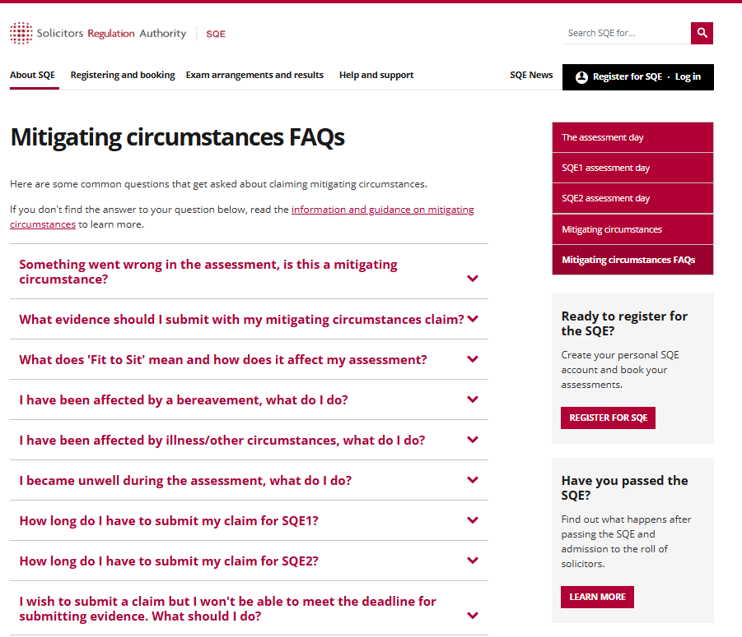
FAQs
Common questions from candidates
Guidance on key areas of the process including possible outcomes
Mitigating circumstances FAQs https://sqe.sra.org.uk/exam-arrangements/the-assessment-day/mitigating-circumstances-faqs
Notes:
Jackie

